Slide 1

Transition Workshop
Supporting children with SEND
Year 6 into Year 7
Elaine Bridle, DSPL7 Manager and Primary SEND Lead
Laura Hussey, Secondary SEND Lead and Post-16 Transition Coordinator
Notes:
Elaine - intros

Slide 2

Notes:
Laura – put which school your CYP is going to in the chat

Slide 3
Aims of this workshop:
To understand the transition process for children with SEND.
To know how to support your children to make a successful transition to secondary school
To explore what will be the same/different for you as parents and your children, particularly in relation to their additional needs
To explore what may make your children (and you!) anxious
To consider how you could support your child by building on their resilience, self-esteem and independence
Notes:
Elaine

Slide 4
Transition process this half term
Handover from Year 6 teacher to Head of Year 7
Primary SENCo will discuss needs with Secondary SENCo
Secondary SENCo invited to Year 6 EHCP reviews
Transition work in Year 6 class
Moving up day on July 13th
Some students may need additional meetings
All records passed on at end of summer term
Notes:
Laura

Slide 5
Transition process this half term
Parents/carers:
There may be additional transition meetings for some children, with key personnel from both settings, and the parent/carer
Secondary SEN team are likely to contact parents/carers to discuss any concerns. Make a list of specific questions and concerns you may have – think about what your child may find most difficult.
Most secondary schools will allow a settling in period before any formal SEN meetings are arranged.
Notes:
Laura

Slide 6

Supporting your child
A lot of the work in preparing your child to start secondary school can be done at home.
Enable developing independence
Each stage in development is a transition
Each stage is exciting, but can also bring new worries
Secondary years are about developing independence and preparing for adulthood
Dependent Independent
Notes:
Elaine – lots of work done in final term of Y6. And throughout Y6.

Slide 7
Enabling independence
Phase 1: Motivating and directing. Building habits (Primary)
Phase 2: Motivating ownership and modelling organisation. Working out how to be independent (Upper KS2-Y7)
Phrase 3: Transfering ownership with support and structure (Y7)
Phase 4: Identifying own problems and finding own solutions (Secondary)
Notes:
Laura

Slide 8
Problem solving
Whose problem is it?
Don’t do everything for them.
If they forget the things they need and you deliver it to school for them, what will they learn?
Part of becoming independent is learning to take responsibility and managing the consequences
Notes:
Laura – with caveats

Slide 9
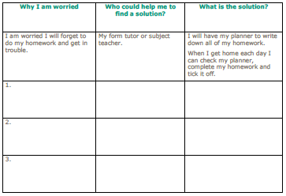
What could be a worry?
If you are anxious, avoid sharing this with your child. They will be reassured by your calming response.
If your child is anxious, try to find out what is worrying them.
Help your child to problem solve and find a solution.
Think about what has worked well in the past when you have helped your child prepare for a new experience.
Extract from Anna Freud transition resources
Notes:
Elaine

Slide 10

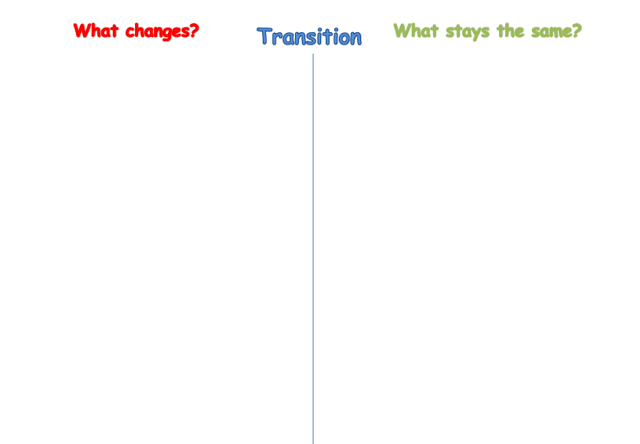


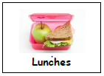
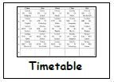
Activities such as ‘What changes? What stays the same?’ can help alleviate some children’s anxieties.
Taken from HPCI transition resources
Notes:
Elaine/Laura
In the chat – what are your CYPs worrying about most

Slide 11
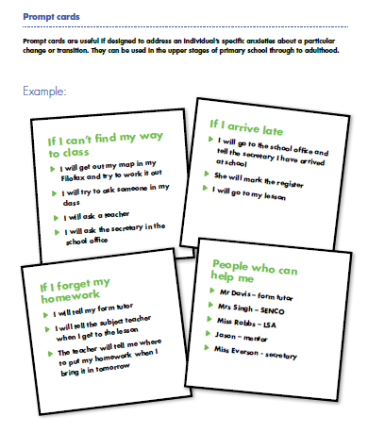
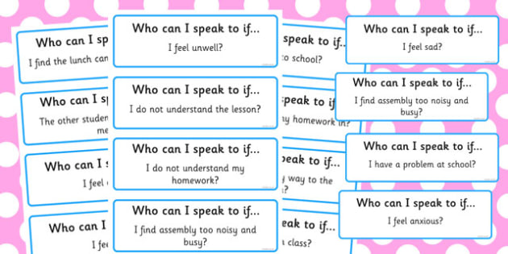
Prompt cards can be useful for some children to help them to remember solutions to problems
Resource available on Twinkl
Notes:
Laura
Prepare before moving up day. They could pass a card of questions/worries to their form teacher.

Slide 12
What can I do to feel more prepared?
Familiarise yourself and your child with the school and its routines, using the school website, calendar and any transition information you have been sent. Seeing photos, or a virtual tour of the school may really help your child and you could make a transition booklet with key information.
There are useful resources on BBC Bitesize to support with transition to secondary school
Aim to provide as many opportunities as possible for your child to develop their independence - walking to meet friends, practising packing their bag, going to the shops, finding information on the school website
Allow them to solve their own problems if possible. Asking how/what questions can be useful: "what could you do?", "what have you already tried?", "who could help you?", "how could you find out more information?"
Build a network of support. They will do network of support activities at secondary school too.
Have appropriate expectations.
Notes:
Elaine

Slide 13
New beginnings
Be positive about the transition!
New sense of responsibility – study, organisation, planning, time management
New steps towards independence – travel, food choices, problem solving
New friends, new opportunities, new subjects to study
An opportunity to have a fresh start
Notes:
Elaine/Laura

Slide 14
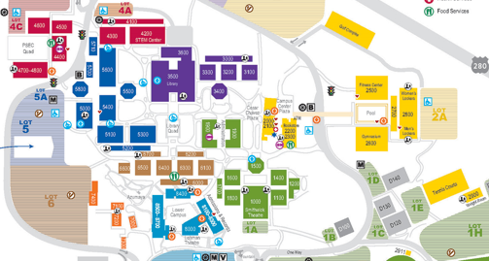
Support – prepare and practise!
Map of the school, learn where key areas are, colour coding and symbols
Laminate a timetable with an equipment list needed for each day
Colour coded plastic wallets for each subject’s exercise and text books
stickers on spines of books
Label all uniform and equipment clearly – have 2 of some items
Teach and practise tying a school tie or taking on and off without undoing
Rehearse the route to school if walking or travelling independently
Look at school rules and any consequence systems
New networks – friendships and peer pressure
Organisation
Budgeting, healthy eating – good choices
Problem solving
Wellbeing
Clubs
Notes:
Laura

Slide 15
It can be a tough time for parents/carers too!
If you're worried, arrange a meeting with the Secondary SENCo or someone in SEN/Year 7 team – this is likely to be more possible in the second half of the summer term once Y11 and Y13 have left.
Approach with an open mind – can be a new start
Use holiday to relax, not to worry about it. Get the stuff at the start, rather than leaving it to the last week when everyone will be in Stevensons.
Often a regression at the start of Y7 – take a step back while adjusting to everything that’s new. Expect more than usual fatigue.
Keep school informed – useful to know the early warning signs
Transition events for parents
Notes:
Laura

Slide 16

Holiday support group
Notes:
Laura

Slide 17

Further support
10-12am
https://www.eventbrite.co.uk/e/school-transitions-managing-anxiety-worries-in-children-young-people-tickets-642076928377?aff=ebdsoporgprofile
Notes:
Laura

Slide 18
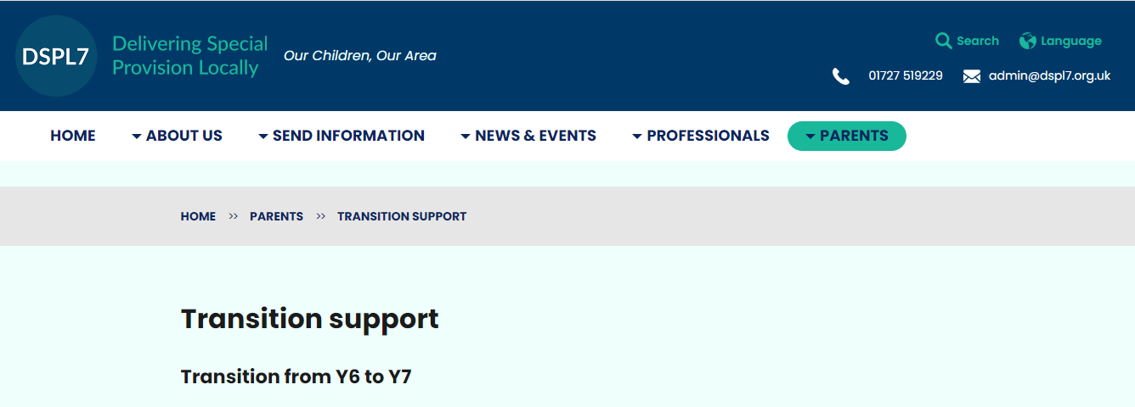
Further support
www.dspl7.org.uk
Notes:
Laura

Slide 19
Questions

