Slide 1


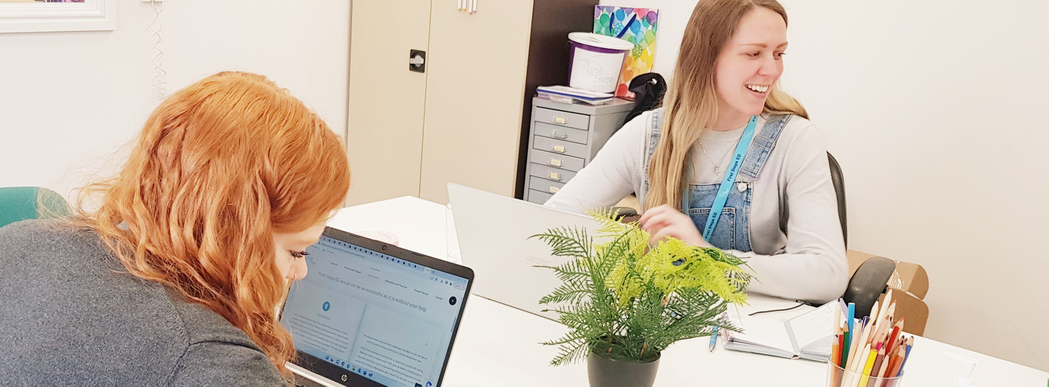
Charity No. 1185092
firststepsed.co.uk
FIRST STEPS ED
A leading eating disorders charity, passionate about providing hope, opportunities, and choices to lives affected by eating difficulties and disorders.
Notes:
Jess – Senior SSO at First Steps ED for Herts

Slide 2


Charity No. 1185092
firststepsed.co.uk
Who can access First Steps?
We are commissioned to support children and young people ages 5-18th Birthday
A Service User does not need to be underweight to access our support
Notes:
Wanted to highlight the difference between EDs and disordered eating
Disordered eating is where someone presents with an ED but they don't meet the full diagnostic criteria for an ED.
As I’m sure you know working in your fields, the earlier the intervention, the better!

Slide 3
Charity No. 1185092
firststepsed.co.uk
Types of Eating Disorders
Anorexia Nervosa
Bulimia Nervosa
Binge Eating Disorder
Orthorexia
OSFED (Other Specified Eating Disorders)
ARFID (Avoidant Restrictive Food Intake Disorder
NO DIAGNOSIS NEEDED

Slide 4
Charity No. 1185092
firststepsed.co.uk
Our Services
Notes:
Services are funded in areas we are commissioned, if anyone fall outside of our commissioned areas then they would have the option to self-fund
One-to-One support. This not a counselling service, but a form of specialised peer support. The sessions would be between the young person and a Specialist Support Officer either virtually via Microsoft Teams or in-person for 10 weeks.
Within these sessions, we can discuss certain topics such as anxiety, body image, relationships with food, self-esteem, but also anything in particular they would like to focus on. The sessions involve identifying triggers, current coping techniques, and exploring alternatives plus thought challenging. They can also use the sessions as a chance to just offload about their week or other issues they may struggling with.
Support is very service user led as well so it really helps them take an active role in their own recovery
Psychotherapy - Adult support is very much around psychotherapy (have a funded option for 16 year olds + in Derbyshire where they get 10 sessions, and then our private therapy sessions of which there are different tiered options)
Befriending service – online support via weekly emails
Nutritional support – delivered by nutritionists, aiming to provide psychoeducation on different foods/food groups, debunk myths around foods, meal and snack ideas etc

Slide 5
Charity No. 1185092
firststepsed.co.uk
Our Services: One to One Support
Young person and a Specialist Support Officer (Via teams or face to face)
10 sessions, each 45 minutes long
Sessions include work around body image, relationships, coping techniques and anything else
Person centred and service user led
Notes:
Services are funded in areas we are commissioned, if anyone fall outside of our commissioned areas then they would have the option to self-fund
One-to-One support. This not a counselling service, but a form of specialised peer support. The sessions would be between the young person and a Specialist Support Officer either virtually via Microsoft Teams or in-person for 10 weeks.
Within these sessions, we can discuss certain topics such as anxiety, body image, relationships with food, self-esteem, but also anything in particular they would like to focus on. The sessions involve identifying triggers, current coping techniques, and exploring alternatives plus thought challenging. They can also use the sessions as a chance to just offload about their week or other issues they may struggling with.
Support is very service user led as well so it really helps them take an active role in their own recovery
Psychotherapy - Adult support is very much around psychotherapy (have a funded option for 16 year olds + in Derbyshire where they get 10 sessions, and then our private therapy sessions of which there are different tiered options)
Befriending service – online support via weekly emails
Nutritional support – delivered by nutritionists, aiming to provide psychoeducation on different foods/food groups, debunk myths around foods, meal and snack ideas etc

Slide 6




Accommodations
For our neurodiverse service users we offer a variety of accommodations to our 1:1 support including:
Flexible session length – sessions can run from anywhere between 20 and 50 minutes depending on the SU’s needs
More creative sessions – we will facilitate drawing exercises, play doh etc
Dim lighting
Fidget and stim toys always provided
We include parents/carers where appropriate
Sessions can be done every other week if the SU needs more time to process

Slide 7
Charity No. 1185092
firststepsed.co.uk
Our Services: Workshops
Wellbeing Workshop
Body Image and Perception Workshop (10-15yrs, 16+)
Boys and Men (12-17yrs)
ARFID Workshop (7-14yrs, 15+)
Notes:
Various workshops for CYP and adults
Wellbeing Workshop - 4 week psychoeducation workshop, aiming to give young people a greater insight into their behaviours, body image and navigate recovery.

Slide 8
Charity No. 1185092
firststepsed.co.uk
Our Services: Skills for Carers
Three-week workshop designed for parents, carers and older siblings
The aim is to support them whilst their loved one is receiving support
The workshop helps develop knowledge and skills to enable someone to support their loved one with eating difficulties and body image concerns
Based on the Maudsley Method
This is currently £45 for the 3 week course and unlimited drop in sessions
The carer doesn’t need a dependent accessing our services
Notes:
‘Skills for Carers’ is a three week workshop series, designed for parents, carers, older siblings supporting someone with an eating disorder. We know how important it is that parents and siblings receive support
Its full of practical tips, scenarios and case studies, designed to help carers develop skills and knowledge to support a loved one with eating difficulties and body image concerns.
Based on the Maudsley method which is all about how the role of parents is fundamental in encouraging their child’s recovery journey.
Alongside that we offer monthly drop in sessions for parents too
The Maudsley Method, also known as Family-Based Treatment, can be characterized by an intensive outpatient treatment where parents are integrated as an active and positive role. The primary purposes of including parents in this approach are to incorporate and encourage participation in their child’s recovery journey.
https://www.eatingdisorderhope.com/treatment-for-eating-disorders/types-of-treatments/maudsley-method-family-therapy

Slide 9
Charity No. 1185092
firststepsed.co.uk
Our Services: School Workshops
Body Image Workshop Session for Primary and Secondary Schools
Assembly's or Smaller Classroom Workshops
45 minutes plus 15 minutes aftercare
Please register interest on our website for more information and pricing:
https://firststepsed.co.uk/services-and-support/support-in-schools/
Notes:
‘Skills for Carers’ is a three week workshop series, designed for parents, carers, older siblings supporting someone with an eating disorder. We know how important it is that parents and siblings receive support
Its full of practical tips, scenarios and case studies, designed to help carers develop skills and knowledge to support a loved one with eating difficulties and body image concerns.
Based on the Maudsley method which is all about how the role of parents is fundamental in encouraging their child’s recovery journey.
Alongside that we offer monthly drop in sessions for parents too
The Maudsley Method, also known as Family-Based Treatment, can be characterized by an intensive outpatient treatment where parents are integrated as an active and positive role. The primary purposes of including parents in this approach are to incorporate and encourage participation in their child’s recovery journey.
https://www.eatingdisorderhope.com/treatment-for-eating-disorders/types-of-treatments/maudsley-method-family-therapy

Slide 10
Charity No. 1185092
firststepsed.co.uk
Our Services: Self Help Guided Resources
We currently have two Self-Help Guided Resources available on our website
First Steps to Recovery – For Service Users contemplating recovery
Parent and Carer Guided Self-Help – For anyone caring for a loved one struggling with an eating disorder or eating distress
These are completely free for anyone in Hertfordshire using code FSEDHERTS .
https://firststepsed.co.uk/training/e-courses/

Slide 11
Charity No. 1185092
firststepsed.co.uk
Training
Learn more through our accredited CPD training courses
Intro to Eating Disorders
Body Image and Perception
Nutrition and Mood
Eating Disorders and Exercise Addiction
Eating Disorders in Boys and Men
NEW Working with ARFID
Group in person or online CPD training
https://firststepsed.co.uk/training/skills-for-eating-disorder-support/
Notes:
If you are wanting more information on eating disorders, we have 5 CPD accredited courses which are pre-recorded so you can do in your own time at your pace.
Ramadan resource – haven't had time to go into this in depth, but we do have various resources on our website aimed at supporting individuals from different faith backgrounds
How can someone fast safely if they have an eating disorder around restrictive eating?
During Ramadan, the main times of the day you will eat is before sunrise and after sunset. Ensure you eat both of these meals as it could put you at risk of relapse or fall back into disordered thoughts and behaviours.
Try not to restrict during the evening meal because you're worried about a potential binge. After the evening meal, you feel full, and for some this can trigger the urge to engage in purging or compensatory behaviours. Remind yourself that it is okay to feel full and think of any distraction techniques you can use during these times (reciting and reflecting on the Qur’an, meditating, watching TV, or undertaking charitable acts)
If you're deciding whether to fast for Ramadan this year, there are a number of key considerations
Who are you fasting for? Is it Allah, or your eating disorder.
Do you have a solid support network?
Are you in a good place in recovery or at risk of relapse
Those who suffer from eating disorders should consult their Doctor before fasting – ensure physical monitoring.
Consult faith leaders - If they feel that fasting would set them back in recovery, there are some reasons why it may not be advisable to fast, particularly for health
Mention physical monitoring

Slide 12
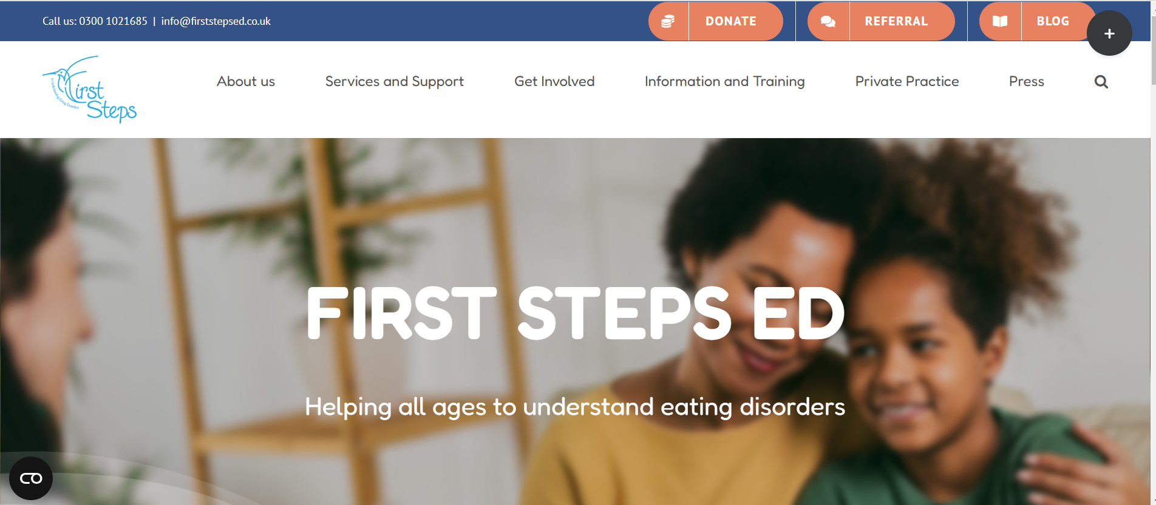
Charity No. 1185092
firststepsed.co.uk
Referral
www.firststepsed.co.uk
Notes:
If you or anyone you know is struggling and may benefit from our support, go to our website to make a referral
That will take you to our referral page. Scroll to the bottom where there is some more information and you can click the make a referral here button to start a referral.
We accept
- Self referrals, referrals from parent or carer and professional referrals
Aim for a 10-15 day turnaround – from when the referral is received to booking in for an assessment

Slide 13
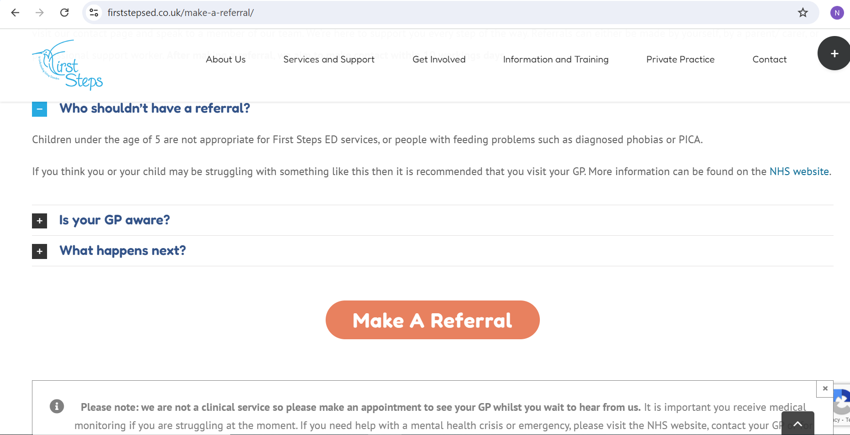
Charity No. 1185092
firststepsed.co.uk
Referral
www.firststepsed.co.uk
Notes:
If you or anyone you know is struggling and may benefit from our support, go to our website to make a referral
That will take you to our referral page. Scroll to the bottom where there is some more information and you can click the make a referral here button to start a referral.
We accept
- Self referrals, referrals from parent or carer and professional referrals
Aim for a 10-15 day turnaround – from when the referral is received to booking in for an assessment

Slide 14
Charity No. 1185092
firststepsed.co.uk
Service User Feedback
“I like feeling understood as no one else does understand. I like being listened to and made to feel valid and being given help that is personal to me. I understand myself a bit more now and that's really nice.”
“I am more able to talk about my feelings and emotions and I am not ashamed to reach out.”
“I liked that I was listened to completely, and that I felt in secure hands. I felt as though I could trust the people I was talking to, and I was listened to extremely well. Honestly I think the service is really useful, and I love that I can also just have a conversation about my day to day life, and open up which helps the journey as a whole.
big big thank you :-)”
“[Staff] was very friendly and approachable. She has built a good connection with [SU] from the very first session. [SU] felt motivated to make efforts with new foods during the week knowing that he can report to [Staff] on his progress. The new food ladder strategy gave [SU] control over the process which was very beneficial.”
“I feel heard and never judged”
“I felt supported both during the sessions and outside of them. It was motivating knowing that I had multiple goals that I could work towards. I felt comfortable and that I was genuinely being listened to. I felt hopeful because [Staff] made me feel like I really could recover.”

Slide 15








Charity No. 1185092
firststepsed.co.uk
Thank You
0300 1021685
www.firststepsed.co.uk
info@firststepsed.co.uk
jessica.pickles@firststepsed.co.uk
@FirstStepsED
Notes:
Thank you again. Here is our contact information if you would like to get in touch and I’d be happy to answer any questions that you may have now.

